Slide 1
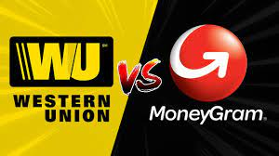
TOPIC :MoneyGram vs. Western Union: A Comparative Analysis
“MoneyGram and Western Union have both established themselves as global leaders in the money transfer industry, but they have different features, strengths, and weaknesses. Through this presentation, we will explore the key differences between these two services”.

Slide 2
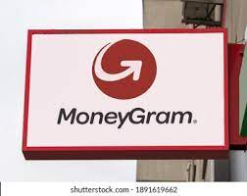
1. OVERVIEW
MoneyGram:
Founded in 1940, MoneyGram is a global money transfer company headquartered in the United States.
Offers services such as person-to-person transfers, bill payments, money orders, and prepaid cards.
Operates in over 200 countries and territories.
With MoneyGram for Business, companies can streamline their international payment processes, optimize foreign exchange, and ensure timely transactions. This service is particularly beneficial for businesses with international operations, enabling them to efficiently manage cross-border payments.

Slide 3

Western Union
Established Industry Leader: With a rich history dating back to 1851
Diverse Transfer Options: Western Union provides customers with various transfer options, including online, mobile app, and in-person transfers.
Provides services like person-to-person transfers, business payments, money orders, and prepaid cards.
Focus on Security: Western Union prioritizes the security of its customers' transactions and personal information. The company utilizes advanced encryption and fraud prevention measures to protect against potential threats and maintain the trust of its users.

Slide 4
2.Transfer Methods
MoneyGram:
Online and Offline Transfers: MoneyGram offers the flexibility of both online and offline transfer options. Customers can conveniently send money through the MoneyGram website or mobile app, or visit a nearby agent location for in-person transfers.
Bank Account Deposit: MoneyGram facilitates direct transfers to recipients' bank accounts, providing a secure and convenient way to deposit funds. This method is suitable for those who prefer the convenience of having funds deposited directly into their accounts.
Mobile Wallet Transfers: MoneyGram has partnered with mobile wallet providers, enabling users to receive funds directly into their mobile wallets. This option offers a digital solution for accessing and managing funds through mobile devices.
Bill Payments: MoneyGram allows customers to conveniently pay bills for various services, including utilities, credit cards, and loans. This feature simplifies the bill payment process, eliminating the need for traditional payment methods.

Slide 5
WesternUnion
Bank Account Deposit: Western Union enables direct transfers to recipients' bank accounts, providing a secure and efficient method for depositing funds. This option is suitable for individuals who prefer the convenience of receiving money directly into their bank accounts.
Mobile Wallet Transfers: Western Union has integrated with mobile wallet providers, allowing recipients to receive funds directly into their mobile wallets.
Business Payments: Western Union also caters to the needs of businesses by providing cross-border payment solutions. Companies can conveniently make payments to suppliers, employees, or partners using Western Union's business payment services.

Slide 6
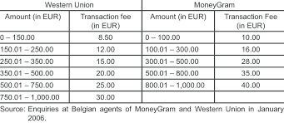
WesternUnion vs MoneyGram

Slide 7


TRANSFER SPEED AND FEES

Slide 8

Transfer Speed and Fees: Western UNION
Cost of $200 domestic transfer is $12.50.
Transfers from one bank to another costs $.99
Sending cash via a credit card or debit card is more expensive
Paying money into bank account using debit card costs $2.99 and paying money into a bank account with credit card costs $17.49.
Transfer speeds depend on the destination and transfer method chosen.
Fees are typically calculated based on the transfer amount and the chosen delivery option.
Currency conversion fees may apply

Slide 9

MoneyGram
Prices for debit and credit card increse by $1 per $100 moved after the first $300 is transferred.
Charges $1.99 if you pay using an online bank account and $1.99-$4.99 if you pay with a debit or credit card.
Fees may include a combination of fixed charges and a percentage of the transfer amount.
Additional fees may apply for currency conversion.

Slide 10
Transfer Limits and Accessibility - MoneyGram:
Transfer Limits: MoneyGram sets transfer limits to ensure security and compliance with regulations.
Accessibility: MoneyGram strives to provide accessibility by offering a vast network of agent locations worldwide. For instance, in countries like the United States, MoneyGram has thousands of agent locations, including popular retail stores, grocery stores, and banks.
Remote Areas and Developing Countries:This approach helps customers in underserved areas access reliable money transfer options and facilitates financial inclusion.

Slide 11
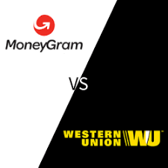
WesternUnion
Transfer limits are influenced by sender and recipient locations, as well as the chosen transfer method.
Western Union boasts a wide network of agent locations globally, ensuring accessibility in various regions.

Slide 12
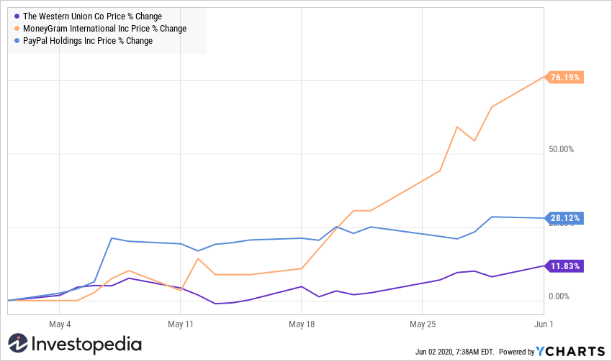

Slide 13


Customer Support and security

Slide 14
5.Customer Support and Security: MoneyGram
Multilingual Customer Support: MoneyGram provides multilingual customer support through various channels, including phone, email, and in-person at agent locations.
Online Help Center:. The help center serves as a self-service option, allowing users to find answers to their questions conveniently.
Fraud Prevention Measures: These measures include advanced encryption technologies, transaction monitoring, and compliance with industry standards and regulations.
Compliance and Anti-Money Laundering (AML) Practices: The company employs rigorous verification processes and monitors transactions to identify and prevent potential fraudulent activities.
Consumer Protection: MoneyGram provides consumer protection measures, such as refund policies and guarantees, to ensure customer satisfaction and address any issues that may arise during the money transfer process.

Slide 15
WesternUnion
Multilingual Customer Support: Similar to MoneyGram, Western Union offers multilingual customer support through various channels, providing assistance in multiple languages to cater to diverse customer needs.
Online Help Center: Western Union also provides an online help center with resources, FAQs, and guides to assist customers with their queries and provide self-service options.
Fraud Prevention Measures: Western Union implements robust security measures, including encryption technologies and transaction monitoring, to safeguard customers' transfers and personal information.
Compliance and AML Practices: Western Union strictly adheres to compliance and AML practices to prevent money laundering and ensure regulatory compliance across its operations.

Slide 16


Slide 17
CONCLUSION
“When choosing between the two, several factors should be considered”.
MoneyGram stands out for its user-friendly online and mobile platforms, diverse transfer options, and a wide network of agent locations. Their focus on accessibility in remote areas and developing countries contributes to their inclusivity.
On the other hand, Western Union offers similar services, emphasizing multilingual customer support, robust security measures, and compliance with regulations. Its well-established brand and global presence provide a sense of reliability.
The best choice between MoneyGram and Western Union depends on individual needs, such as preferred transfer methods, destination countries, transfer speeds, and fees. It is recommended to compare their specific offerings, fees, and exchange rates for your specific transfer requirements to determine which provider aligns best with your needs.

